Slide 1
Project 1
Crafting Compelling Web Presences

Slide 2
Task:1
Understandings of Services and Created short descriptions for 3 Courses from Guvi.
1. Guvi Online Courses:
Guvi is an online learning platform .
They provide courses on programming languages like Python, Java, JavaScript, as well as courses on web development, data science, artificial intelligence, machine learning, and more.
Courses on Guvi are often structured in a way that facilitates progressive learning. They typically start with foundational concepts and gradually move towards more advanced topics, ensuring a comprehensive understanding of the subject matter.
Guvi's courses often include interactive elements such as video lectures, quizzes, coding exercises, and projects. This interactive approach keeps learners engaged and helps reinforce their understanding of the material.

Slide 3
2. Full stack Development Program:
Guvi's Full Stack Development Program aims to provide a comprehensive and practical learning experience that prepares individuals for success in the field of full-stack development.
Comprehensive Curriculum: The program covers both front-end and back-end development technologies, providing a well-rounded understanding of the full stack. Learners typically delve into topics such as HTML, CSS, JavaScript for front-end development, along with server-side languages like Node.js, Python, or Ruby for back-end development. Databases, frameworks, and tools commonly used in full-stack development are also included.
Emphasis on hands-on projects for practical learning.
Interactive learning environment with video lectures, coding exercises, and quizzes.
Industry-relevant skills aligned with current job market demands.
Flexible self-paced learning and supportive community with certification upon completion.

Slide 4
3. Advanced Programming & Data Science.
Comprehensive Curriculum: Covers advanced topics in programming and data science, including algorithms, data structures, machine learning, and data analysis.
Hands-on Projects: Emphasizes practical application through projects that allow learners to apply concepts learned in real-world scenarios.
Interactive Learning: Utilizes a variety of learning resources such as video lectures, coding exercises, quizzes, and assignments to engage learners actively.
Industry-Relevant Skills: Equips learners with in-demand skills sought after by employers in fields like software development, data analysis, and machine learning.

Slide 5
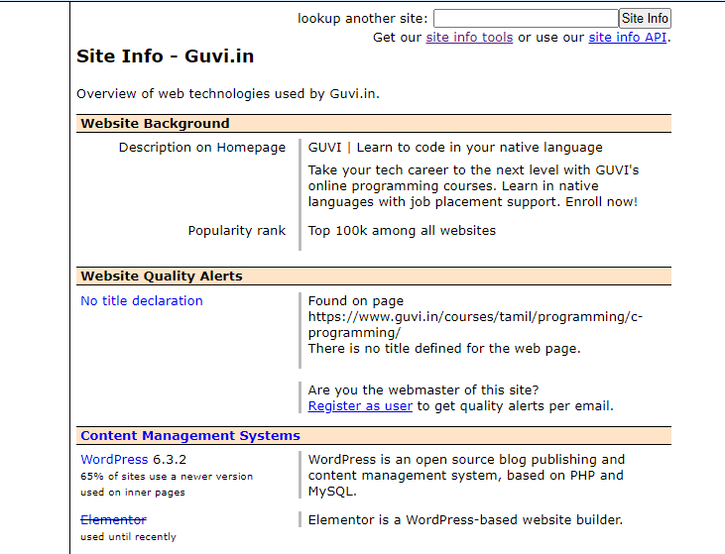
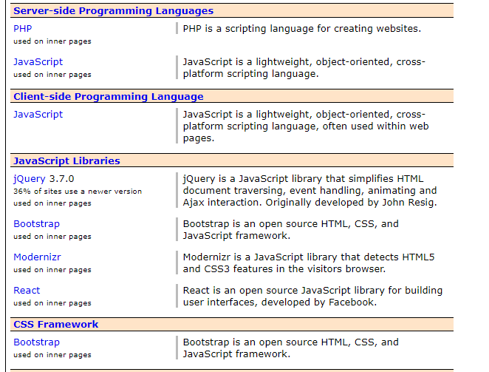
Task 2
Determining the Platform on which the Guvi website is used.
Here sharing the Tool used.
Tool: https://w3techs.com/sites
For Response Website dint support just adding tools
https://websiteresponsivetest.com/

Slide 6
Task 3
Website speed optimization for Desktop and Mobile.
Certainly, here are three main uses of a website's responsive design and mobile optimization:
Improved User Experience: Responsive design and mobile optimization ensure that your website looks and functions well across a variety of devices and screen sizes, including smartphones, tablets, and desktops. This enhances the user experience by providing consistent and easy-to-navigate content, regardless of the device being used. Users are more likely to stay on your website and engage with its content if they can access it seamlessly on their preferred device.
Increased Reach and Accessibility: With the proliferation of mobile devices, a significant portion of internet traffic comes from smartphones and tablets. By optimizing your website for mobile devices, you can reach a broader audience and make your content accessible to users who primarily browse the internet on their phones. This is particularly important for businesses targeting mobile users or local customers who are likely to search for information on-the-go.
Enhanced SEO Performance: Search engines like Google prioritize mobile-friendly websites in their search results, especially for searches conducted on mobile devices. Websites with responsive design and mobile optimization are more likely to rank higher in search engine results pages (SERPs) for relevant queries, leading to increased visibility and organic traffic. Additionally, Google's mobile-first indexing means that the mobile version of your website is considered the primary version for indexing and ranking purposes, further emphasizing the importance of mobile optimization for SEO.

Slide 7
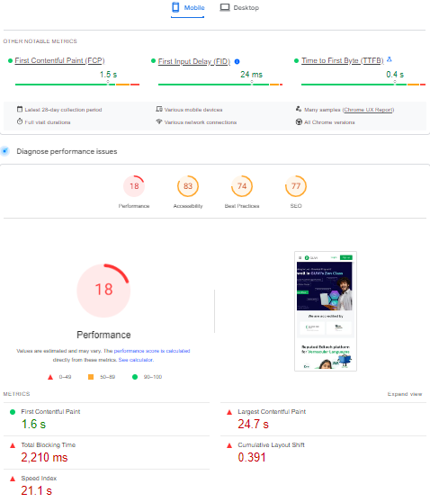
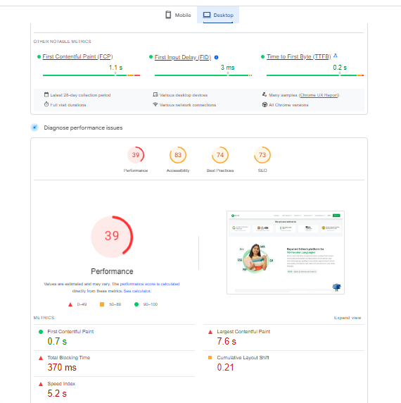
Guvi Homepage
Speed - Mobile
Speed - Desktop

Slide 8
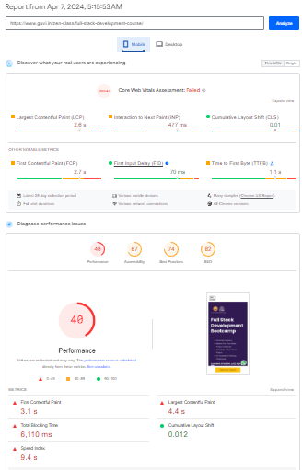
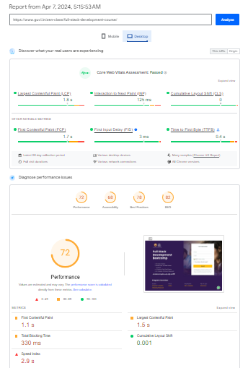
Fullstack Development Course Page
Speed - Mobile
Speed Desktop

Slide 9
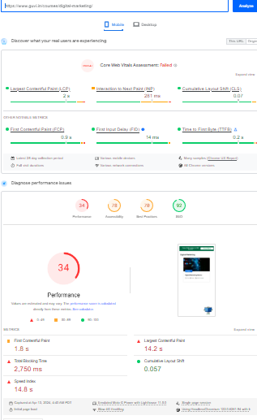
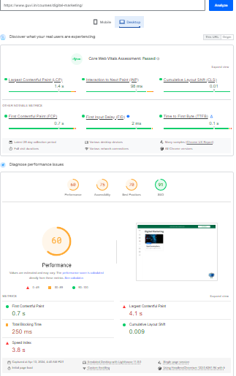
Digital Marketing Course Page
Speed - Mobile
Speed - Desktop

Slide 10
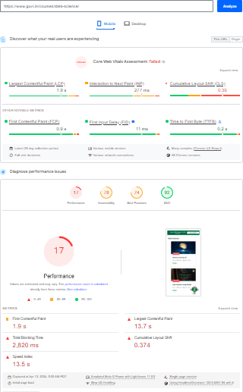
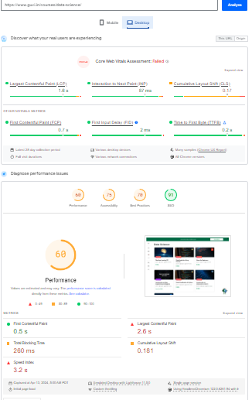
Data Science Course Page
Speed - Mobile
Speed - Desktop

Slide 11
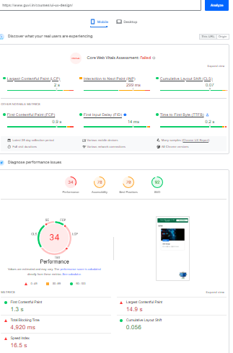
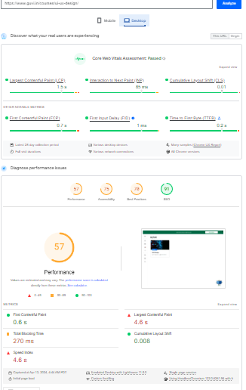
UI/UX Course Page
Speed - Mobile
Speed - Desktop

Slide 12
Task 4
Common website design mistakes to avoid, such as cluttered layouts and slow loading times
Cluttered Layout:
Avoid overcrowding your website with too much content or elements.
Use whitespace effectively to create a clean and organized layout.
Prioritize the most important information and declutter unnecessary elements.
Poor Navigation:
Ensure that navigation menus are clear, intuitive, and easy to find.
Use descriptive labels for menu items to guide users effectively.
Implement breadcrumbs and search functionality to assist users in finding their desired content.
Slow Loading Times:
Optimize images and multimedia content to reduce file sizes.
Minimize HTTP requests by combining CSS and JavaScript files.
Utilize caching techniques and content delivery networks (CDNs) to improve loading speeds.

Slide 13
Non-Responsive Design:
Design your website to be responsive and adaptable to various screen sizes and devices.
Test your website across different devices and resolutions to ensure a consistent user experience.
Prioritize mobile-friendly design elements such as touch-friendly buttons and legible text.
Lack of Clear Call-to-Action (CTA):
Place prominent and visually appealing CTAs strategically throughout your website.
Use action-oriented language to encourage users to take the desired action.
Ensure that CTAs stand out from other elements on the page to attract attention.

Slide 14
Task 5
Best practices for creating visually appealing and user-friendly Website Designs.
Responsive Design:
Ensure your website is optimized for various devices and screen sizes to provide a consistent experience across platforms.
Use fluid grids and flexible images to adapt to different resolutions.
Clear Visual Hierarchy:
Establish a clear hierarchy of elements using size, color, and contrast to guide users' attention and improve readability.
Highlight important content and calls-to-action to make them easily identifiable.

Slide 15
Whitespace Utilization:
Incorporate ample whitespace to create breathing room between elements and enhance readability.
Whitespace can help reduce visual clutter and make the layout appear more organized and inviting.
Accessible Design:
Ensure your website is accessible to all users, including those with disabilities, by following WCAG guidelines.
Provide alternative text for images, use descriptive link text, and ensure keyboard navigation is possible.
Optimized Media:
Optimize images and multimedia content to minimize loading times and improve performance.
Use appropriate file formats, compression techniques, and lazy loading to optimize media delivery.

